Slide 1
Botany
(Study of plants)

Slide 2
CHAPTER 11: TRANSPORT IN PLANTS

Slide 3
Transport in plants; an introduction
Plants don’t have circulatory system.
Materials to be transported by plants: Water, mineral nutrients, organic nutrients and plant growth regulators (phytohormones).
Transport in plants | By/Through | Examples
Short distance transport
Long distance transport (Translocation)
Diffusion
Cytoplasmic streaming
Within the cell
Across the membranes
From cell to cell
Within the tissue
Unidirectional transport of water from roots to very tip of the growing stem.
The multidirectional transport of photosynthates (food synthesised by the leaves) to all parts including the root tips embedded deep inside the soil and storage organs.
Polarised or unidirectional transport of hormones or plant growth regulators and other chemical signals
Through the vascular system
(xylem & phloem)

Slide 4
Means of transport
Passive Transport
No use of energy in the form of Adenosine triphosphate (ATP)
Molecules moves from higher concentration to lower concentration gradient.
Generally independent of temperature & inhibitors
Active Transport
Use of energy in the form of Adenosine triphosphate (ATP)
Occurs against concentration gradient
Dependent on temperature & inhibitors

Slide 5
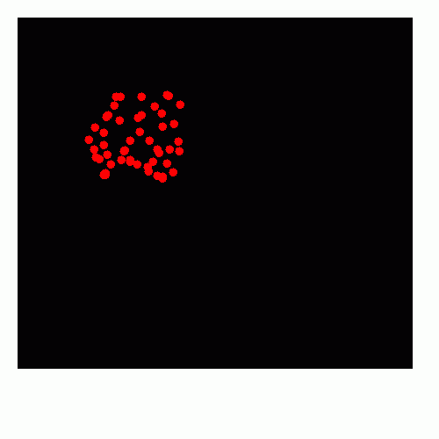
Diffusion
Slow, random and passive movement of molecules (no energy expenditure takes place) from regions of higher concentration to regions of lower concentration till equilibrium is attained.
Diffusion occurs from one part of the cell to the other, or from cell to cell, or from the inter- cellular spaces of the leaf to the outside.
Diffusion is the only means for gaseous movement within the plant body.
Diffusion is a not dependent on a ‘living system’.
Diffusion is obvious in gases and liquids, but diffusion in solids is more likely rather than of solids.

Slide 6
Factors affecting diffusion rate
Diffusion rates are affected by
the gradient of concentration (higher the concentration, faster is the diffusion)
the permeability of the membrane separating them,
Temperature (Higher temperature creates molecules with higher kinetic energy and hence faster is diffusion)
pressure.
size of the substances undergoing diffusion (smaller substances diffuse faster)
Solubility of diffusing substance in lipids. (Lipids soluble substances diffuse faster through the membrane. Substances with hydrophilic moiety find it difficult to pass through the membrane)

Slide 7
Facilitated Diffusion
Facilitated diffusion involves special membrane proteins (like carrier or transport protein, porins, aquaporins, etc) which help in passive movement of substances with hydrophilic moiety across membranes without expenditure of ATP energy.
Membrane proteins provide sites at which such molecules cross the membrane.
Membrane proteins do not set up a concentration gradient
A concentration gradient must already be present for molecules to diffuse even if facilitated by the proteins.
Facilitated diffusion cannot cause net transport of molecules from a low to a high concentration –this would require in put of energy.
Transport rate reaches a maximum when all of the protein transporters are being used (saturation).
Facilitated diffusion is very specific; it allows cell to select substances for uptake.
It is sensitive to inhibitors which react with protein side chains.
The proteins form channels in the membrane for molecules to pass through.
Some proteins channels are always open; others can be controlled.
Some protein channels are large, allowing a variety of molecules to cross.
The porins are proteins that form large pores in the outer membranes of the plastids, mitochondria and some bacteria allowing molecules up to the size of small proteins to pass through.

Slide 8
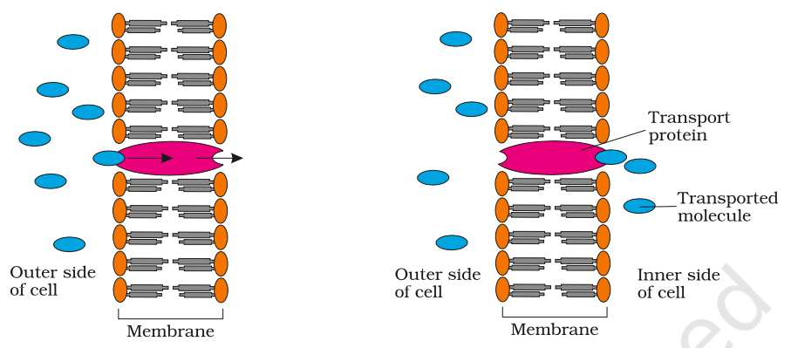
Figure An extracellular molecule bound to the transport protein; the transport protein then rotates and releases the molecule inside the cell, E.g., water channels – made up of eight different types of aquaporins.

Slide 9
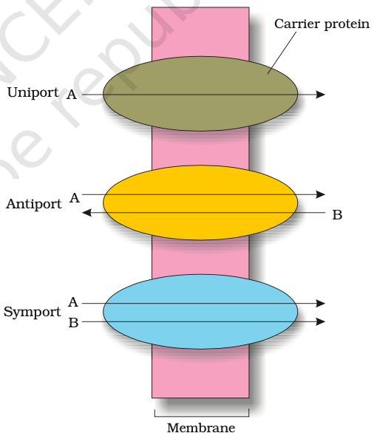
Passive symports and antiports
Some carrier or transport proteins allow diffusion only if two types of molecules move together.
Both molecules cross the membrane in the same direction in a symport
Molecules move in opposite directions in an antiport.
Molecule moves across a membrane independent of other molecules in uniport.

Slide 10
Active Transport
Active transport uses energy to transport and pump molecules against a concentration gradient.
Active transport is carried out by specific membrane-proteins. Hence different proteins in the membrane play a major role in both active as well as passive transport.
Pumps are proteins that use energy to carry substances across the cell membrane.
These pumps can transport substances from a low concentration to a high concentration (‘uphill’ transport).
Transport rate reaches a maximum when all the protein transporters are being used or are saturated.
The carrier protein is very specific in what it carries across the membrane.
These proteins are sensitive to inhibitors that react with protein side chains.

Slide 11
TABLE Comparison of Different Transport mechanism
Properties | Diffusion | Facilitated Diffusion | Active transport
Requires special membrane proteins | No | Yes | Yes
Highly selective | No | Yes | Yes
Transport saturates | No | Yes | Yes
Uphill transport | No | No | Yes
Requires ATP energy | No | No | Yes
Proteins in the membrane are responsible for facilitated diffusion and active transport and hence show common characterstics of being highly selective; they are liable to saturate, respond to inhibitors and are under hormonal regulation. But diffusion whether facilitated or not – take place only along a gradient and do not use energy.

Slide 12
Mitosis/Equational division
Parent Cell
(2n)
2n
2n
Daughter Cells

Slide 13
Meiosis/Reductional division
Parent Cell
(2n)
M I
n
n
M II
n
n
n
n
Daughter Cells

Slide 14
Cell Cycle
The sequence of events by which a cell duplicates its genome, synthesises the other constituents of the cell and eventually divides into daughter cells.
Guiescent stage (G₀) phase: Cell do not proliferate, but metabolically active
Gap 1 phase: cell is metabolically active & continuously grows
Interphase
S or Synthesis phase: DNA synthesis
G₁
PMAT
G₀
S
Cytokinesis
Telophase
Gap 2 phase: proteins synthesis & growth
Anaphase
M phase
Metaphase
G₂
Prophase

Slide 15
Mitosis/Equational division
Meiosis/Reductional division
Parent Cell
(2n)
Parent Cell
(2n)
M I
n
n
2n
2n
M II
Daughter Cells
n
n
n
n
Daughter Cells

Slide 16
Chromosomes
A pair of sister chromatids
Centromere
Kinetochore
Chromatid

Slide 17
Table: Stages of Mitosis/Mitotic division/Equational cell division
Stages of mitosis |  | Major sequence of events observed during mitosis (As observed via electron microscope)
Interphase
Karyokinesis | Prophase
 | Metaphase
 | Anaphase
 | Telophase
Cytokinesis
Nuclear membrane and nucleolus are distinct
Network of chromatins appear within the nucleus
Cytoplasm is visible
Nuclear membrane
Chromatins
Cytoplasm
Nuclear membrane and nucleolus disappear
Chromatins condense to form chromosomes (with two chromatids joined by centromeres).
Start forming spindle fibre
Chromosomes
Metaphase chromosomes get attached to the spindle fibres by their kinetochores of centromeres
Metaphase plate is observed
Metaphase plate
Spindle fibres
Centromere divides and separate sister chromatids
Sister chromosomes moves to opposite poles of the cell
Chromosomes uncoil and form network of chromatin
Nuclear membrane and nucleolus reappear
Two nuclei are seen within a cell
Nuclei
In animal cell, furrow/constriction in plasma membrane deepens and joins in the center to divide cytoplasm into two, eventually forming two daughter cells.
In plant cell, cell wall formation begins with cell plate formation at the center of parent cell where Golgi bodies assemble, eventually forms two daughter cells
Chromatins
Constriction

Slide 18
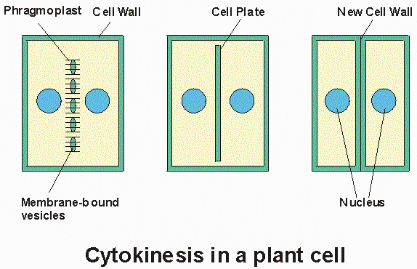

Slide 19
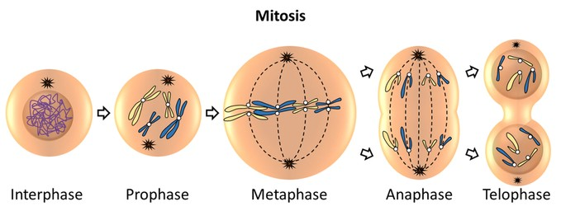

Slide 20
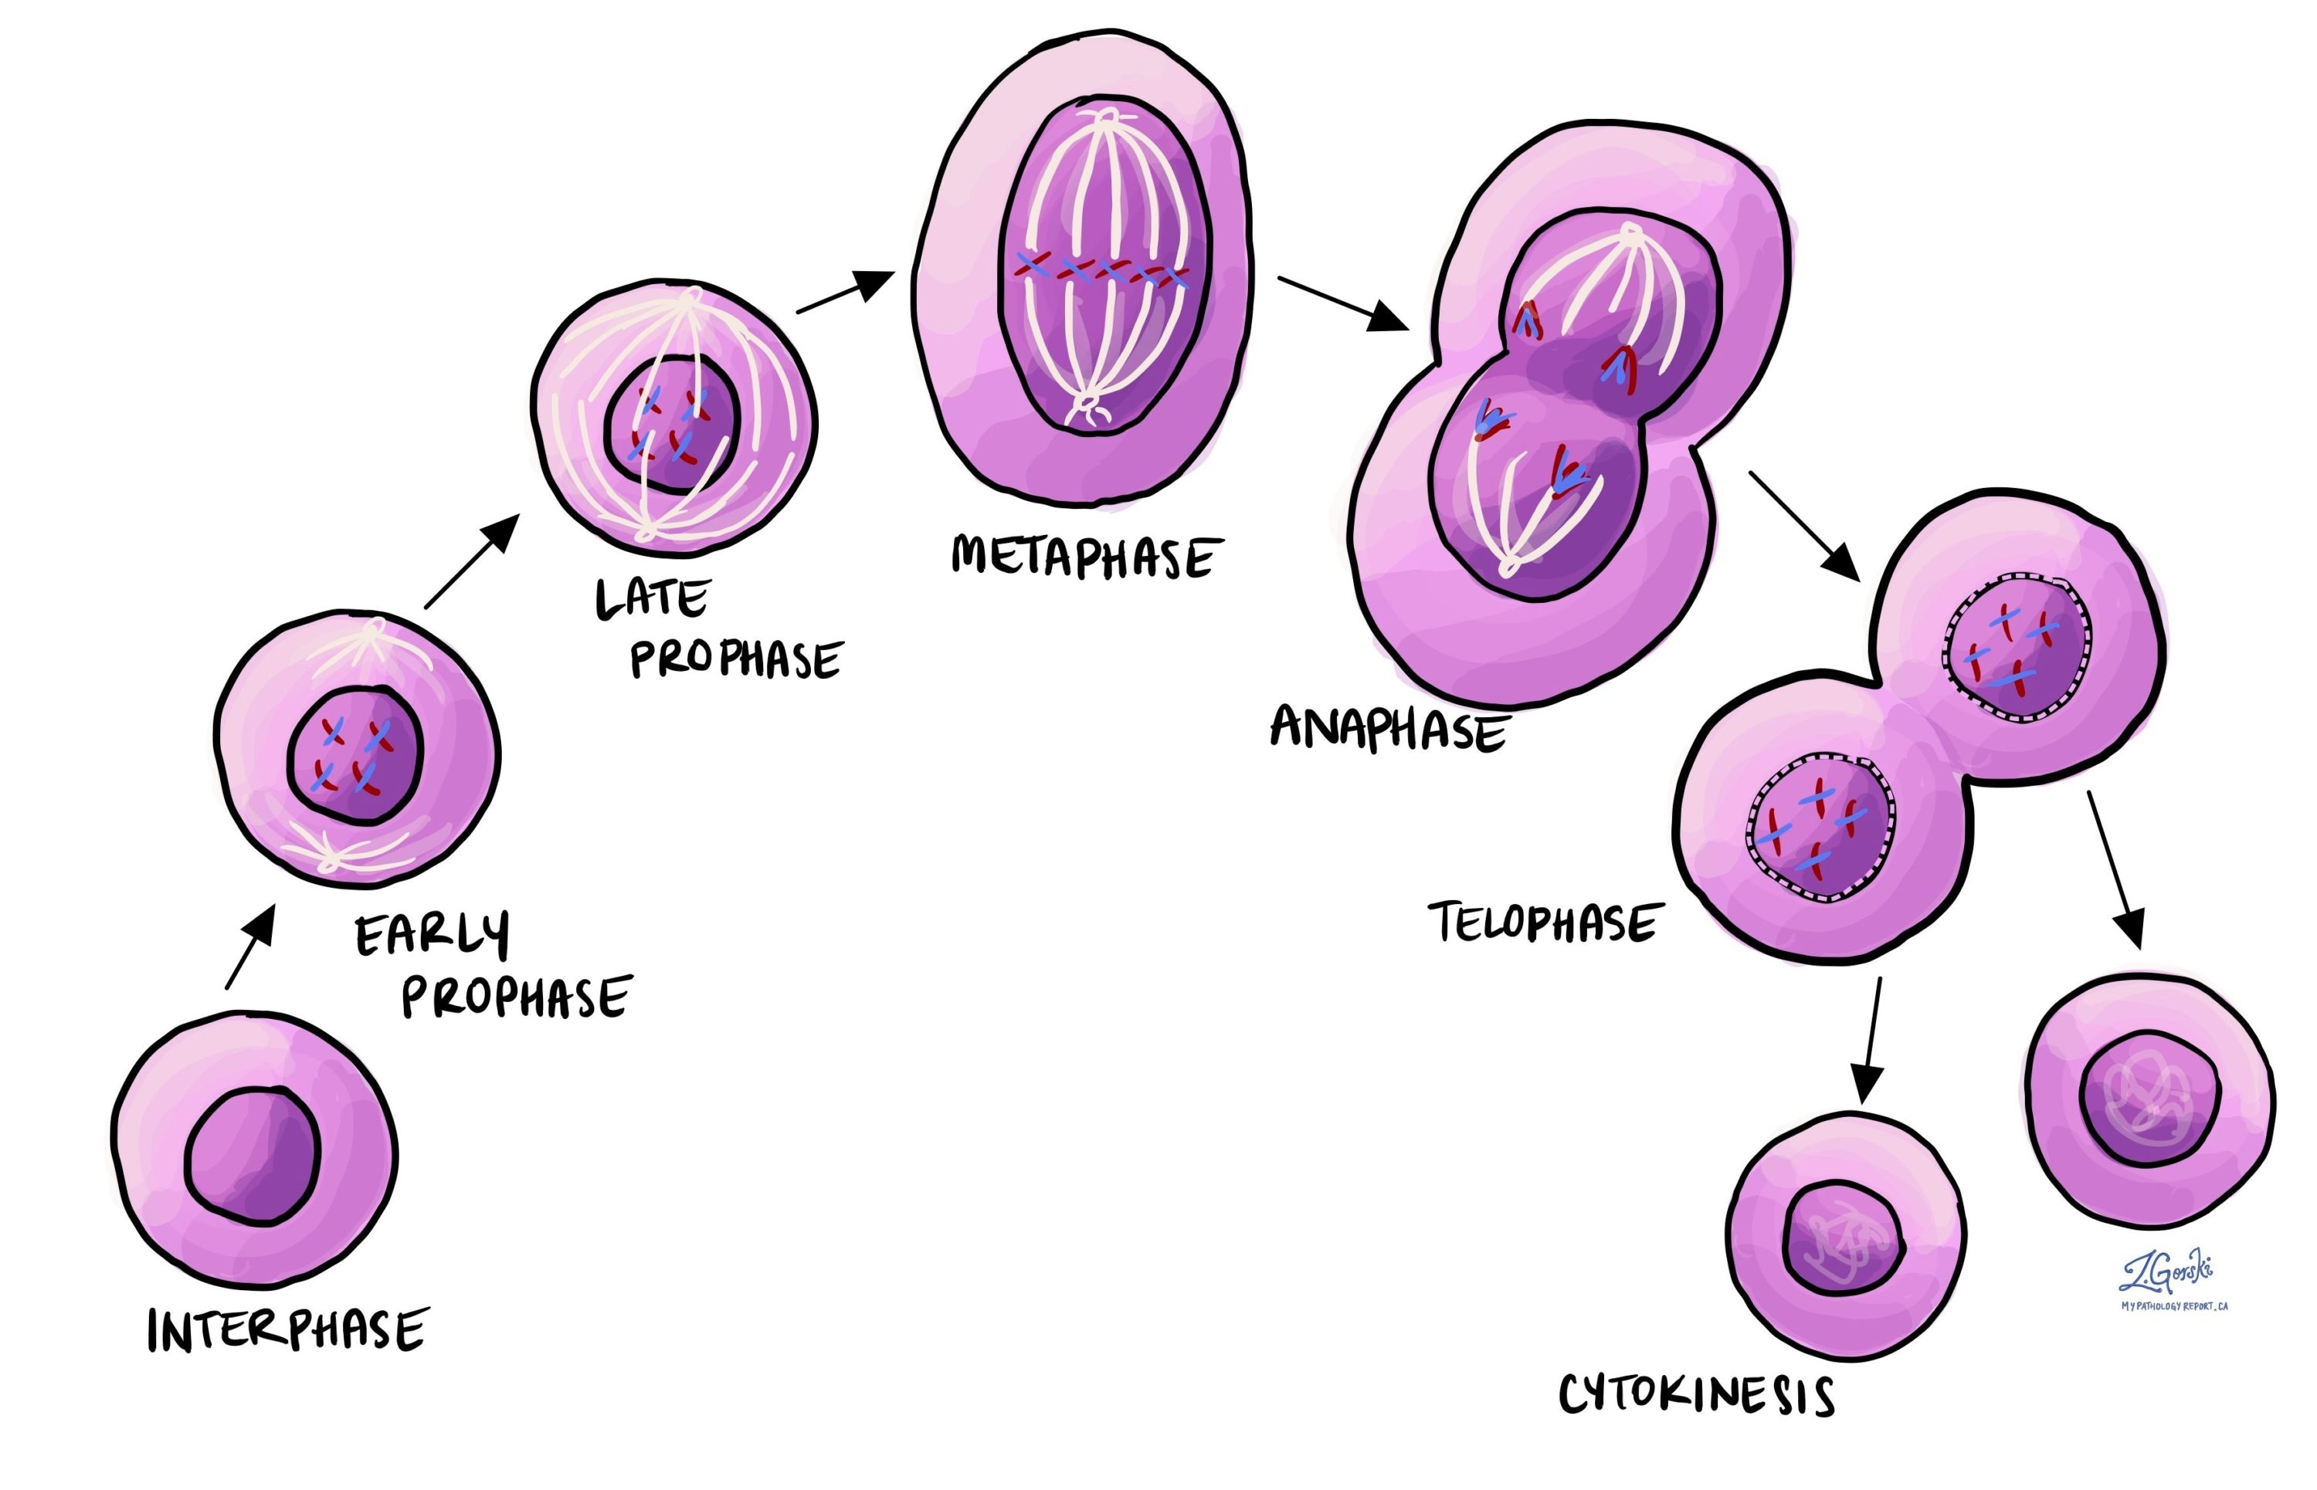
Stages of Mitosis/Mitotic division/Equational cell division

Slide 21
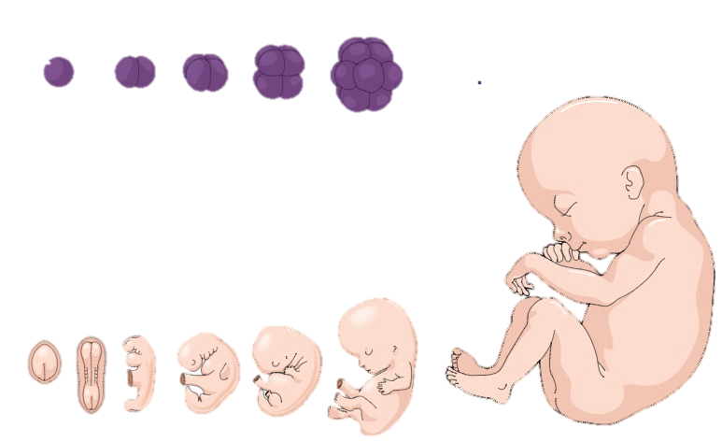
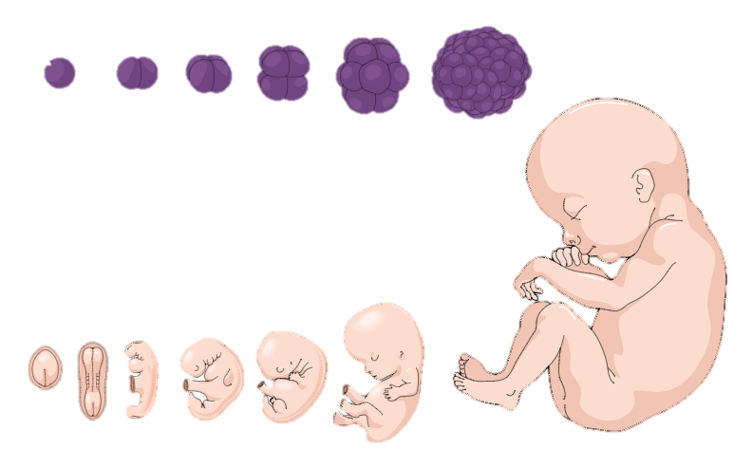
Significance of mitosis
Daughter Cell (2n)
Mitosis forms diploid daughter cells with identical genotype
Mitosis helps in growth of multi-cellular organisms. For example; embryo development in animals, mitotic division of meristem results in continuous growth of plant.
Regeneration
Mitosis contributes to cell repairing. Cells of upper layer of epidermis, lining of the gut, and blood cells are being constantly replaced.
Maintain nucleo-cytoplasmic ratio which is being disturbed due to cell growth
Parent Cell
(2n)
Daughter Cell (2n)

Slide 22
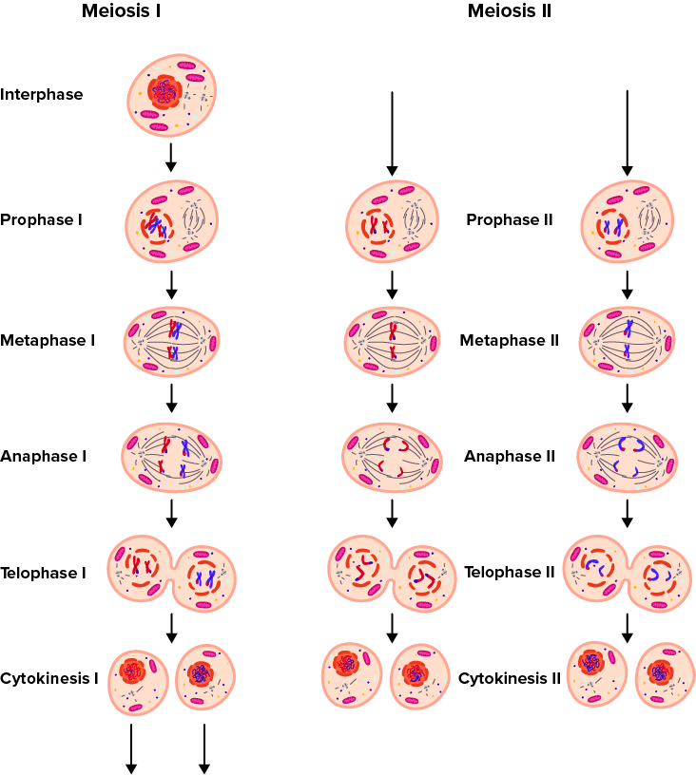

Slide 23
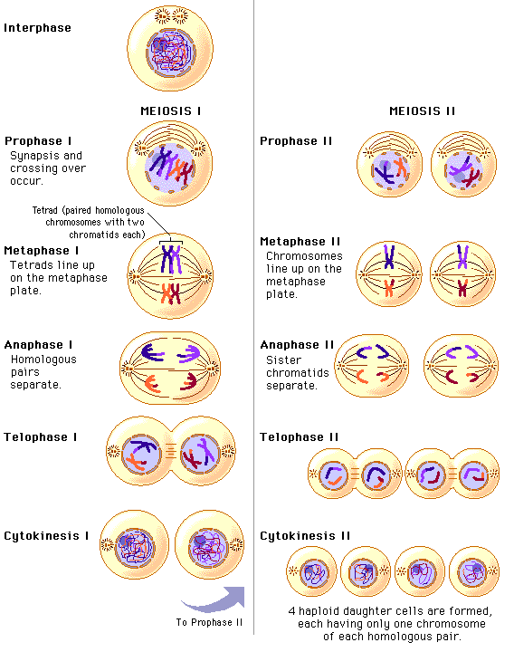

Slide 24
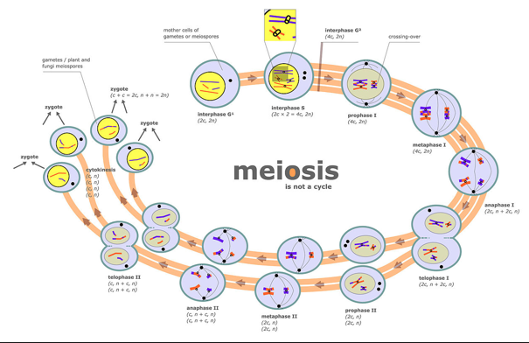

Slide 25

Table: Meiosis/Meiotic division/Reductional division
Stages of meiosis |  | Major sequence of events observed during mitosis (As observed via electron microscope)
Meiosis I | Prophase I (Five phases based on chromosomal behaviour) | Leptotene (Leptonema) (leptos = slender tene = band or thread)
 |  | Zygotene (Zygonema) (Zygon = paired)
 |  | Pachytene (Pachynema) (pachy = thick)
 |  | Diplotene (Diplonema) (diplos = double)
Compact chromosomes are visible.
Homologous chromosomes start pairing
Synapsis (Process of association of homologous chromosomes) of chromosomes occur accompanied by formation of synaptonemal complex.
Duplicated maternal chromosome
Duplicated paternal chromosome
Bivalent chromosomes appear as tetrad (complex formed by a pair of synapsed homologous chromosomes).
Appear recombination nodules (sites at which crossing over occurs between non-sister chromatids of the homologous chromosomes)
Occurs crossing over /Recombination (Recombinase mediated exchange of genetic materials between two homologous chromosomes leading to recombination of genetic materials on the two chromosomes).
Recombination nodule
Tetrad
Dissolution of the synaptonemal complex
Appear chiasmata (X-shaped structures) formed by homologous chromosomes
Recombined homologous chromosomes of the bivalents separated from each other except at the sites of crossing overs.
In oocytes of some vertebrates, diplotene can last for months or years.

Slide 26
Table: Meiosis/Meiotic division/Reductional division
Stages of meiosis |  | Major sequence of events observed during mitosis (As observed via electron microscope)
Meiosis I | Prophase I (Further subdivided into five phases) | Leptotene/Leptonema
 |  | Zygotene/Zygonem
 |  | Pachytene/Pachynema
 |  | Diplotene/Diplonema
 | Diakinesis (Dia = opposite; kinesis= separation or movement)
 | Metaphase I
 | Anaphase I
 | Telophase I
 | Cytokinesis
Termination of chiasmata
Chromosomes condense fully
Assemble meiotic spindle to prepare the homologous chromosomes for separation.
By the end of diakinesis, the nucleolus disappears and the nuclear envelope also breaks down.
Diakinesis represents transition to metaphase.
The bivalent chromosomes align on the equatorial plate
The microtubules from the opposite poles of the spindle attach to the pair of homologous chromosomes.
Metaphase plate
The homologous chromosomes separate and move to opposite poles of cell, while sister chromatids remain associated at their centromeres.
Separating homologous chromosomes
Nuclear membrane and nucleolus appear
Dyad of cells is observed

Slide 27
Table: Meiosis/Meiotic division/Reductional division
Interkinesis |  | Short lived stage between Meiosis I and Meiosis II
Meiosis II | Prophase II
 | Metaphase II
 | Anaphase II
 | Telophase II
 | Cytokinesis
The nuclear membrane disappears by the end of prophase II
The chromosomes again become compact.
Chromosomes align at the equator by getting attached to the spindle fibre to the kinetochores of sister chromatids.
Division of the centromere of each chromosome
Separated chromosomes move towards opposite poles of cells
Nuclear envelope encloses chromosomes and occur cytokinesis.
Results in the formation of tetrad of cells i.e., four haploid daughter cells are formed.

Slide 28
Significance of meiosis
Meiosis conserve specific chromosome number of each species across generations
Meiosis increases the genetic variability in the population of organisms from one generation to the next.
Contributes to evolution by inheritance of variation via sexual reproduction.

Slide 29
PLANT PHYSIOLOGY
The description of structure and variation of living organisms over a period of time, ended up as two, apparently irreconcilable perspectives on biology.
The two perspectives essentially rested on two levels of organisation of life forms and phenomena.
Ecology and related disciplines: organismic and above level of organisation
Physiology and biochemistry: cellular and molecular level of organisation.
The processes of mineral nutrition of plants, photosynthesis, transport, respiration and ultimately plant growth and development are described in molecular terms but in the context of cellular activities and even at organism level. Wherever appropriate, the relation of the physiological processes to environment is also discussed.

Slide 30
PLANT PHYSIOLOGY
The description of structure and variation of living organisms over a period of time, ended up as two, apparently irreconcilable perspectives on biology.
The two perspectives essentially rested on two levels of organisation of life forms and phenomena.
Ecology and related disciplines: organismic and above level of organisation
Physiology and biochemistry: cellular and molecular level of organisation.
The processes of mineral nutrition of plants, photosynthesis, transport, respiration and ultimately plant growth and development are described in molecular terms but in the context of cellular activities and even at organism level. Wherever appropriate, the relation of the physiological processes to environment is also discussed.

Slide 31
Chapter Ends Here!

Slide 32
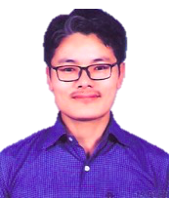
Teacher
Mr. Lhakpa Wangyal
PGT Biology
Email: lhakpawangyal@gmail.com
Contact number: 84497 99894
Social Baluni Public School

Slide 33
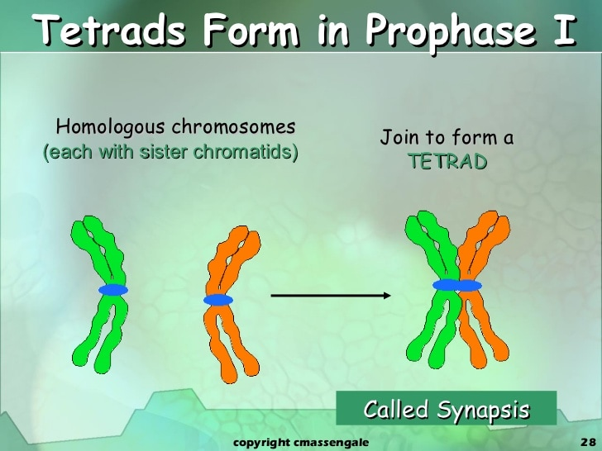

Slide 34
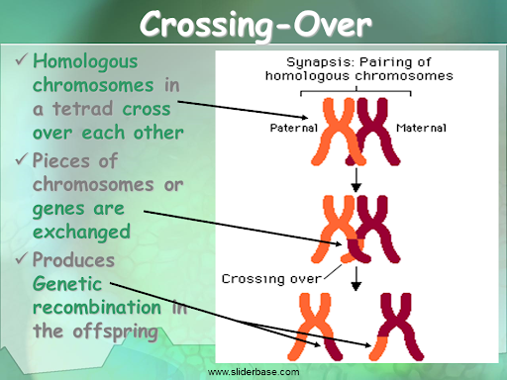

Slide 35
